Slide 1
Urban SDK Assignment

Slide 2
Topics
Snowflake
PowerBI
Key Metrics
Challenges

Slide 3
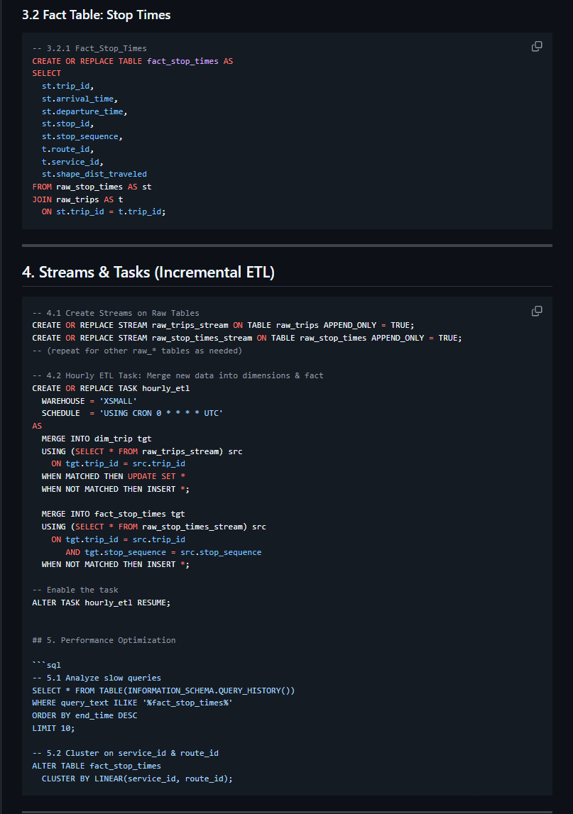
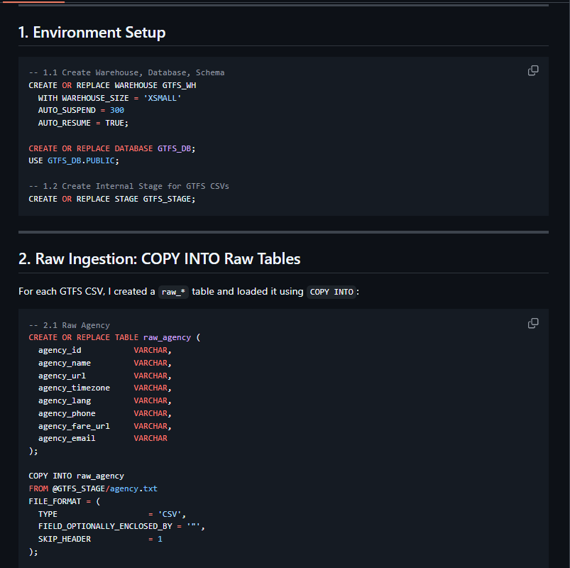
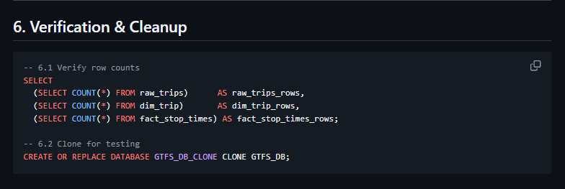
Snowflake steps
Environment setup
Raw ingestion
Dimensional tables
Fact table
Streams & Tasks
Performance tuning

Slide 4
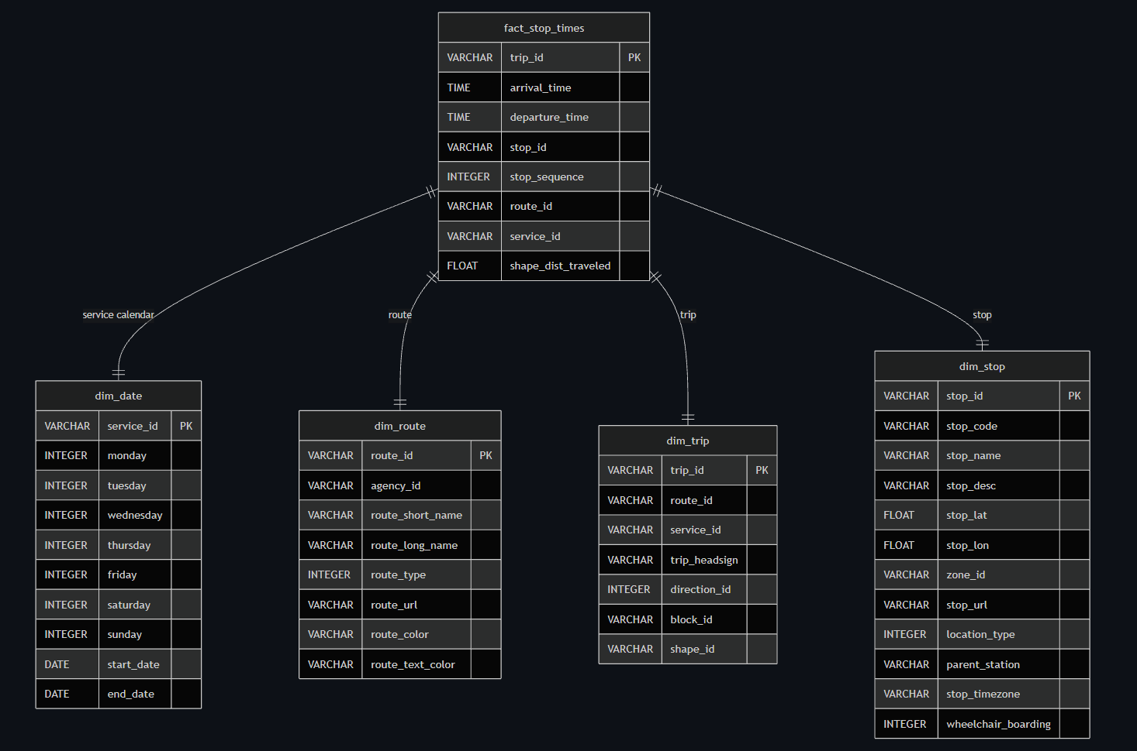
Star Schema
Fact Table
Dimension Tables
Relationships
All linked to fact table

Slide 5
Star Schema
Fact Table
Dimension Tables
Relationships
All linked to fact table

Slide 6
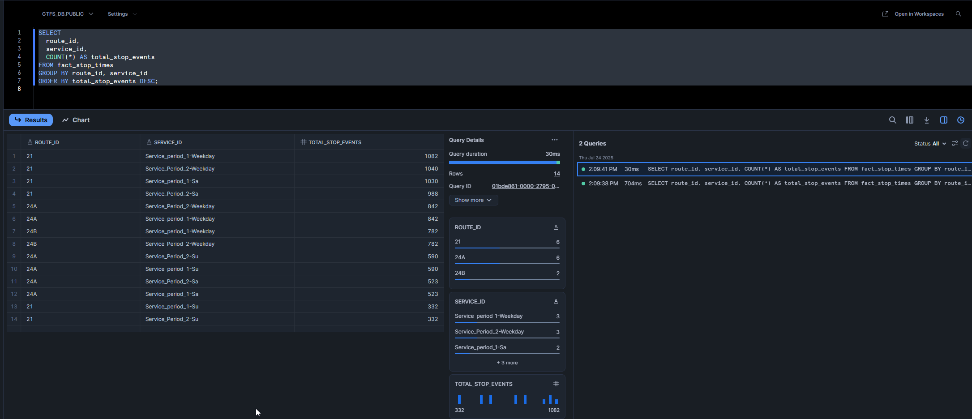
Query Caching
670ms difference

Slide 7
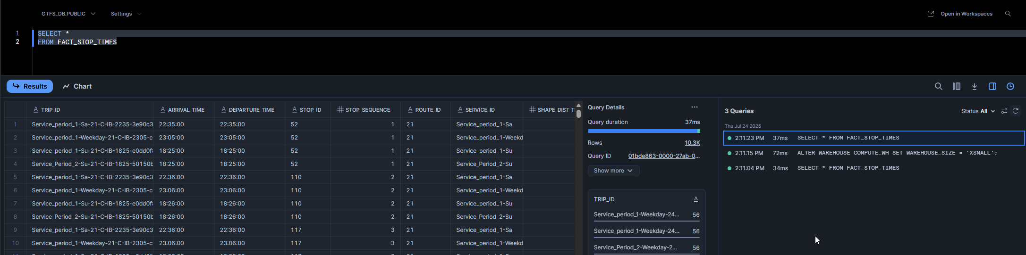
Warehouse resizing
Nominal difference in large dataset (fact table)
With more data in the DB query run times will increase

Slide 8
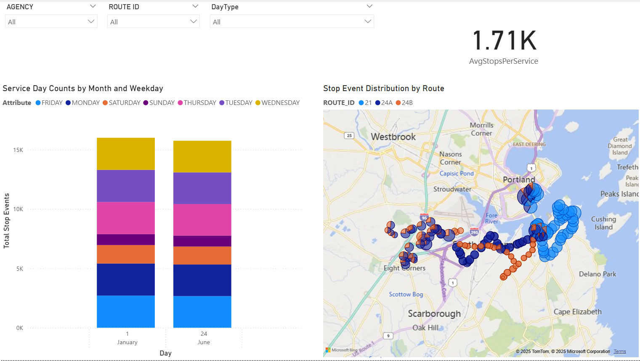
Key Metrics
Service Day Counts by Month/Weekday]
Average Stops Per Service
Stop Event Distribution by Route
Slicers at the top of dashboard

Slide 9
Challenges
Not enough date data to show a true time series trend that is useful
DirectQuery does not allow for post ingestion transformation, only measures and some column DAX
Limited understanding of data points and useful metrics outside of the GTFS spec

